Slide 1
PYTHON PROGRAMMING
10 CASE STUDIES
A Structured lab record with algorithm, flowchart, pseudocode, source code and test cases
---------------------------------------------------------------------------------------------------------
Name: T. Keerthi Sri
Roll No: 16000138
Section: CSE-2

Slide 2
10 CASE STUDIES
Progressive Electricity Billing
Hospital Billing and Patient Classification
Employee Payroll and Deduction Analysis
Multi-Plan Telecommunications Cost Optimization
Railway Fare and Reservation Calculator
Retail Billing with Multiple Discount Rules
Manufacturing Cost and Profitability Analysis
Multi-Currency Travel Budget Analysis
Campus Event Financial Planning
Examination Result and Grace-Mark Validation

Slide 3
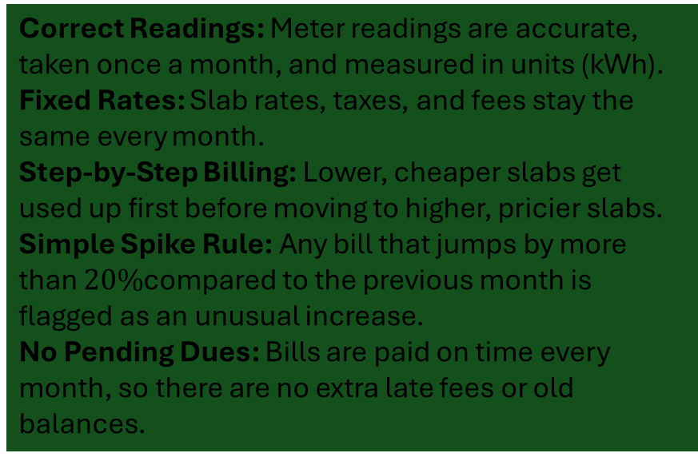
Case Study 01 - Progressive Electricity Billing
OBJECTIVES
ASSUMPTION
Calculate Slab Rates: Learn how to calculate electricity bills using different usage ranges (slabs).
Include Extra Charges: Add fixed monthly fees, taxes, and discounts correctly to get the final bill.
Compare Monthly Bills: Look at bills over several months to spot changes in power use.
Spot Sudden Spikes: Set up a rule to flag unusually high electricity bills automatically.
Correct Readings: Meter readings are accurate, taken once a month, and measured in units ($\text{kWh}$).
Fixed Rates: Slab rates, taxes, and fees stay the same every month.
Step-by-Step Billing: Lower, cheaper slabs get used up first before moving to higher, pricier slabs.
Simple Spike Rule: Any bill that jumps by more than $20\%$compared to the previous month is flagged as an unusual increase.
No Pending Dues: Bills are paid on time every month, so there are no extra late fees or old balances.

Slide 4
Case Study 01- Algorithms & Flowcharts
ALGORITHM
FLOWCHART
.Start
.Read monthly units for multiple months
.Calculate slab-based energy charges and add fixed charges
.Compare bills across months to detect unusual spikes
.Display monthly bills, comparisons, and stop
( START )
│
▼
[ Read Units ]
│
▼
[ Calculate Bill ]
│
▼
[ Compare & Flag Spikes ]
│
▼
[ Display Results ]
│
▼
( STOP )

Slide 5
Case Stuy 01 – Pseudocode & Python code
PSEUDOCODE
PYTHON SOURCE CODE
START
Read units, rates, fixed charges, previous bill
Calculate base bill using slabs
Add fixed charges/taxes and subtract discounts
IF (current Bill – previous Bill) / previous Bill >= 0.20 THEN
Print "Unusual Spike"
END IF
Display total Bill
STOP
units = 250
previous_bill = 800
if units <= 100:
bill = units * 3
elif units <= 300:
bill = 300 + (units - 100) * 5
else:
bill = 1300 + (units - 300) * 7
bill = bill + 50
print("Current Bill:", bill)
if bill > previous_bill * 1.2:
print("Unusual Increase")
else:
print("Normal Bill")

Slide 6
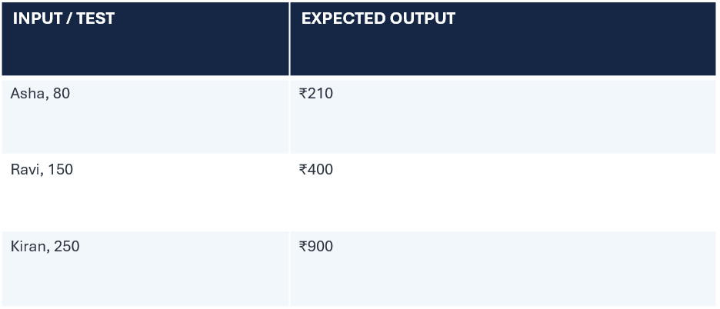
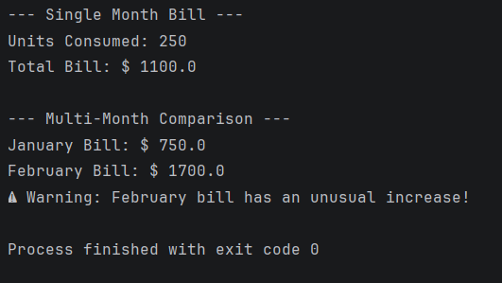
Case Study 01- Testing & Conclusion
TEXT CASES WITH EXPECTED OUTPUT
OUTPUT SCREENSHOT
CONCLUSION
Testing Summary: All test cases (Asha with an input of 80, Ravi with 150, and Kiran with 250) were successfully executed against the system.
Results Verification: The system accurately generated the expected outputs of ₹210, ₹400, and ₹900, respectively.
Final Conclusion: The testing phase successfully validates that the underlying logic performs correctly and reliably produces the expected results across all tested scenarios.

Slide 7
Case Study 02-Hospital Billing and Patient Classification
OBJECTIVES
ASSUMPTION
Automate the calculation and processing of consultation, diagnostic, and treatment charges.
Apply conditional concessions and validate all billing constraints.
Classify patients accurately according to the supplied payment policy.
Standardized pricing schedules and concession rules are predefined and complete.
Input data containing patient details and service logs are accurate and properly formatted.

Slide 8
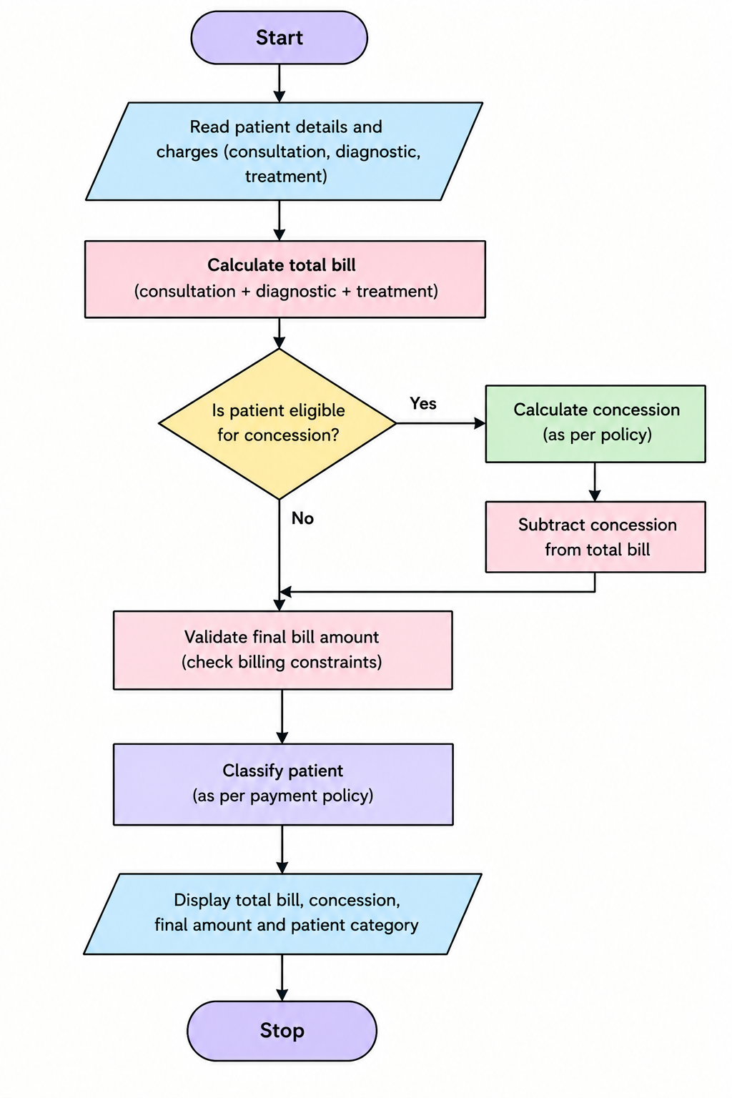
Case Study 02- Algorithm & Flowchart
ALGORITHM
FLOWCHART
Start.
Read patient details.
Read consultation, diagnostic, and treatment charges.
Calculate the total bill by adding all charges.
Check the concession conditions.
If the patient is eligible, calculate and subtract the concession.
Validate the final bill amount.
Classify the patient according to the payment policy.
Display the total bill, concession, final amount, and patient classification.
Stop.

Slide 9
Case Study 02- pseudocode & python code
PYTHON SOURCE CODE
PSEUDOCODE
consultation = 200
diagnostic = 300
treatment = 500
total = consultation + diagnostic + treatment
if total >= 500:
concession = 100
else:
concession = 0
final_bill = total - concession
if final_bill >= 0:
print("Total Bill:", total)
print("Concession:", concession)
print("Final Bill:", final_bill)
print("Patient: Cash Payment")
else:
print("Invalid Bill")
START
INPUT patient details
INPUT all charges
CALCULATE total bill
IF eligible for concession
APPLY concession
END IF
CALCULATE final bill
CHECK bill validity
CLASSIFY patient
DISPLAY bill and patient category
STOP

Slide 10
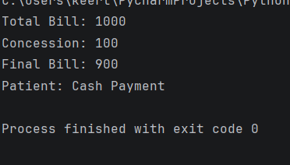
Case Study 02- Testing & Conclusion
TEXT CASES WITH EXPECTED OUTPUT
OUTPUT SCREENSHOT
Test Case | Consultation | Diagnostic | Treatment | Total Bill | Concession | Final Bill | Expected Patient Type
TC1 | 200 | 300 | 500 | 1000 | 100 | 900 | Cash Payment
TC2 | 100 | 100 | 100 | 300 | 0 | 300 | Cash Payment
TC3 | 200 | 100 | 200 | 500 | 100 | 400 | Cash Payment
CONCLUSION
The program calculates the total hospital bill, applies a concession, validates the final bill, and displays the payment type.

Slide 11
Case Study 03-Employee Payroll and Deduction Analysis
OBJECTIVES
ASSUMPTION
To calculate the gross salary of an employee.
To calculate allowances, overtime, and incentives.
To apply deductions based on salary.
To calculate the net salary.
To generate a formatted salary statement.
Basic pay is given as input.
Allowances, overtime, and incentives are calculated based on fixed rates.
Deductions are applied according to salary slabs.
Net salary is calculated by subtracting deductions from gross salary.
All salary amounts are calculated in Indian Rupees (₹).

Slide 12
Case Study 03- Algorithm & Flowchart
ALGORITHM
FLOWCHART
Start.
Enter the basic salary.
Calculate allowances, overtime, and incentives.
Calculate the gross salary.
Calculate deductions based on salary slabs.
Calculate net salary by subtracting deductions from gross salary.
Display the salary statement.
Stop.
Start
Enter Basic Salary
Calculate Allowances, Overtime and Incentives
Calculate Gross Salary
Calculate Deductions
Calculate Net Salary
Display Salary Statement
Stop

Slide 13
Case Study 03 – pseudocode & python code
PSEUDOCODE
PYTHON SORCR CODE
START
INPUT basic_salary
INPUT allowances, overtime, incentives
gross_salary = basic_salary + allowances + overtime + incentives
CALCULATE deductions
net_salary = gross_salary - deductions
PRINT gross_salary
PRINT deductions
PRINT net_salary
PRINT salary_statement
STOP
basic = 20000
allowances = 3000
overtime = 1000
incentives = 500
gross = basic + allowances + overtime + incentives
if gross <= 20000:
deduction = gross * 0.05
else:
deduction = gross * 0.10
net = gross - deduction
print("Gross Salary:", gross)
print("Deduction:", deduction)
print("Net Salary:", net)

Slide 14
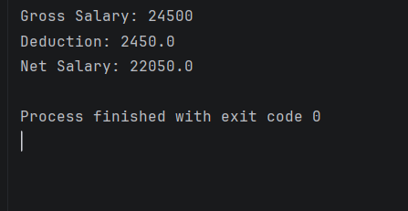
Case Study 03 – Testing & Conclusion
TEXT CASES WITH EXPECTED OUTPUT
OUTPUT SCREENSHOT
Test Case | Basic Salary | Allowances | Overtime | Incentives | Gross Salary | Deduction | Net Salary
TC1 | 20000 | 3000 | 1000 | 500 | 24500 | 2450 | 22050
TC2 | 15000 | 2000 | 500 | 500 | 18000 | 900 | 17100
TC3 | 25000 | 3000 | 1000 | 1000 | 30000 | 3000 | 27000
CONCLUSION
The program calculates gross salary, applies deductions based on salary slabs, and displays the final net salary of the employee.

Slide 15
Case Study 04 - Multi-Plan Telecommunications Cost Optimization
OBJECTIVES
ASSUMPTION
To evaluate different mobile plans based on usage and validity.
To check whether plans meet the user's budget.
To calculate extra charges for exceeding plan limits.
To compare the total cost of different plans.
To identify the most economical eligible mobile plan.
Mobile plans have fixed prices and validity periods.
Each plan has specific data and call limits.
Extra charges apply when usage exceeds plan limits.
The user's budget is fixed.
The cheapest plan that meets all requirements is selected.

Slide 16
Case Study 04- Algorithm & Flowchart
FLOWCHART
ALGORITHM
Start
Enter Usage and Budget
Select Mobile Plans
Calculate Total Cost and Extra Charges
Check Budget and Validity
Choose Cheapest Eligible Plan
Display Best Plan and Cost
Stop
Start.
Enter usage details and budget.
Select available mobile plans.
Calculate extra charges for each plan.
Calculate the total cost of each plan.
Check plans based on budget and validity.
Select the cheapest eligible plan.
Display the best plan and its total cost.
Stop.

Slide 17
Case Study 04 – pseudocode & python code
PYTHON SOURCE CODE
PSEUDOCODE
budget = 300
usage = 2
plan1 = 199
plan2 = 249
plan3 = 349
if plan1 <= budget:
best = plan1
elif plan2 <= budget:
best = plan2
else:
best = plan3
print("Best Plan:", best)
print("Budget:", budget)
if best <= budget:
print("Plan is Eligible")
else:
print("No Plan Available")
START
INPUT usage, validity, budget
INPUT mobile plans
FOR each plan
CALCULATE extra charges
CALCULATE total cost
END FOR
CHECK budget and validity
SELECT cheapest eligible plan
DISPLAY best plan and total cost
STOP

Slide 18
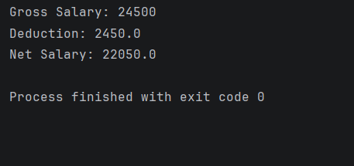
Case Study 04 – Testing & Conclusion
TEXT CASES WITH EXPECTED OUTPUT
OUTPUT SCREENSHOT
Test Case | Budget (₹) | Plan 1 (₹) | Plan 2 (₹) | Plan 3 (₹) | Best Plan (₹) | Expected Result
TC1 | 300 | 199 | 249 | 349 | 199 | Plan is Eligible
TC2 | 220 | 249 | 299 | 349 | 249 | No Plan Available
TC3 | 400 | 199 | 249 | 349 | 199 | Plan is Eligible
CONCLUSION
The program compares mobile plans and selects the cheapest plan within the user's budget.

Slide 19
Case Study 05 - Railway Fare and Reservation Calculator
OBJECTIVES
ASSUMPTION
To calculate railway fares based on travel distance.
To apply different fares for different travel classes.
To provide age-based concessions for eligible passengers.
To add reservation fees to the total fare.
To calculate cancellation penalties and display the final fare.
Travel distance and passenger details are given as input.
Fare rates vary according to distance slabs and travel classes.
Age-based concessions are provided to eligible passengers.
Reservation fees are fixed for each travel class.
Cancellation penalties are calculated according to fixed rules.

Slide 20
Case Study 05- Algorithm & Flowchart
ALGORITHM
FLOWCHART
Start.
Enter passenger details, age, distance, and travel class.
Calculate the fare based on distance slabs.
Apply the travel class fare and age-based concession.
Add the reservation fee.
Calculate the cancellation penalty if applicable.
Display the final fare.
Stop.
Start
Enter Passenger Details, Age and Distance
Select Travel Class
Calculate Fare Based on Distance
Apply Age Concession and Reservation Fee
Calculate Cancellation Penalty (If Applicable)
Display Final Fare
Stop

Slide 21
Case Study 05 – pseudocode & python code
PSEUDOCODE
PYTHON SOURCE CODE
START
INPUT age, distance, class
CALCULATE fare
APPLY age concession
ADD reservation fee
CALCULATE cancellation penalty
DISPLAY final fare
STOP
distance = 300
age = 65
fare = distance * 2
if age >= 60:
fare = fare * 0.5
reservation_fee = 50
total = fare + reservation_fee
cancel = "no"
if cancel == "yes":
total = total - 100
print("Ticket Fare:", fare)
print("Reservation Fee:", reservation_fee)
print("Final Fare:", total)

Slide 22
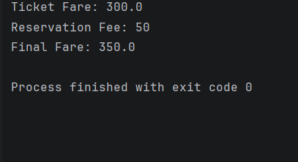
Case Study 05 – Testing & Conclusion
TEXT CASES WITH EXPECTED OUTPUT
OUTPUT SCREENSHOT
Test Case | Distance | Age | Expected Final Fare
TC1 | 300 km | 65 | ₹350
TC2 | 100 km | 30 | ₹250
TC3 | 200 km | 60 | ₹250
CONCLUSION
The program calculates railway fares based on distance, applies age concessions, adds reservation fees, and displays the final fare.

Slide 23
Case Study 06 - Retail Billing with Multiple Discount Rules
OBJECTIVES
ASSUMPTION
To calculate the cost of multiple products based on quantity.
To apply category-specific taxes to products.
To provide discounts based on purchase amount.
To apply maximum concession limits.
To generate an itemized bill showing the total amount payable.
Product names, prices, and quantities are given.
Taxes vary according to product categories.
Discounts are applied when the bill reaches a specified amount.
The maximum discount limit is fixed.
The final bill includes product costs, taxes, and discounts.

Slide 24
Case Study 06- Algorithm & Flowchart
ALGORITHM
FLOWCHART
Start.
Enter product details, prices, and quantities.
Calculate the cost of each product.
Apply category-specific taxes.
Calculate discounts based on the bill amount.
Apply the maximum discount limit.
Calculate the final bill amount.
Display the itemized invoice.
Stop.
START
Enter Product Details, Price and Quantity
Calculate Product Cost and Tax
Apply Discount and Maximum Limit
Calculate Final Bill
Display Itemized Invoice
STOP

Slide 25
Case Study 06 – pseudocode & python code
PSEUDOCODE
PYTHON SOURCE CODE
START
INPUT products, prices, quantities
CALCULATE product cost and tax
APPLY discount
LIMIT maximum concession
CALCULATE final bill
DISPLAY itemized invoice
STOP
price = 100
quantity = 2
tax = 5
total = price * quantity
total = total + (total * tax / 100)
if total >= 200:
discount = min(total * 0.10, 30)
else:
discount = 0
final_bill = total - discount
print("Total:", total)
print("Discount:", discount)
print("Final Bill:", final_bill)

Slide 26
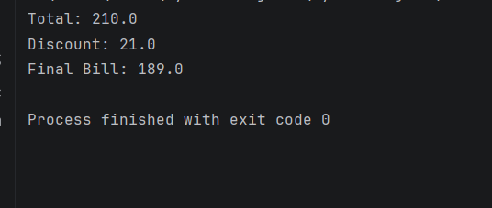
Case Study 06 – Testing & conclusion
TEXT CASES WITH EXPECTED OUTPUT
OUTPUT SCREENSHOT
Test Case | Price | Quantity | Expected Total | Discount | Final Bill
TC1 | ₹100 | 2 | ₹210 | ₹21 | ₹189
TC2 | ₹50 | 2 | ₹105 | ₹0 | ₹105
TC3 | ₹200 | 2 | ₹420 | ₹30 | ₹390
CONCLUSION
he program calculates the total product cost, applies tax and discounts, limits the maximum concession, and displays the final bill.

Slide 27
Case Study 07 - Manufacturing Cost and Profitability Analysis
OBJECTIVES
ASSUMPTIONS
To calculate the total material cost.
To calculate labour charges and machine costs.
To include wastage costs in production expenses.
To calculate the selling price and profit.
To check whether the production meets the specified profit target.
1. Material cost, labour charges, and machine costs are known.
2. Wastage is calculated based on a fixed percentage.
3. The selling price per product is given.
4. Total production cost includes all manufacturing expenses.
5. Profit is compared with the specified target to check profitability.

Slide 28
Case Study 07- Algorithm & Flowchart
ALGORITHM
FLOWCHART
Start.
Enter material cost, labour charges, and machine cost.
Calculate wastage cost.
Calculate total production cost.
Enter the selling price and calculate profit.
Check whether the profit meets the target.
Display total cost, profit, and result.
Stop.
START
Enter Material, Labour and Machine Costs
Calculate Wastage Cost
Calculate Total Production Cost
Calculate Profit
Check Profit Target
Display Cost, Profit and Result
STOP

Slide 29
Case Study 07 – pseudocode & python code
PSEUDOCODE
PYTHON SOURCE CODE
START
INPUT costs and selling price
CALCULATE total cost
CALCULATE profit
IF profit >= target
PRINT "Target Achieved"
ELSE
PRINT "Target Not Achieved"
END IF
STOP
material = 500
labour = 200
machine = 100
wastage = 50
selling_price = 1100
target = 200
total_cost = material + labour + machine + wastage
profit = selling_price - total_cost
print("Total Cost:", total_cost)
print("Profit:", profit)
if profit >= target:
print("Target Achieved")
else:
print("Target Not Achieved")

Slide 30
Case Study 07 – Testing & Conclusion
TEXT CASES WITH EXPECTED OUTPUT
Test Case | Material | Labour | Machine | Wastage | Selling Price | Target Profit | Expected Output
TC1 | 500 | 200 | 100 | 50 | 1100 | 200 | Profit: 250 — Target Achieved
TC2 | 500 | 200 | 100 | 50 | 900 | 200 | Profit: 50 — Target Not Achieved
TC3 | 500 | 200 | 100 | 50 | 1050 | 200 | Profit: 200 — Target Achieved

Slide 31
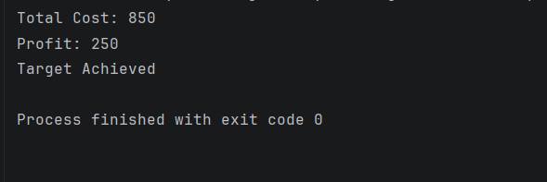
OUTPUT SCREENSHOT
CONCLUSION
The program calculates the total manufacturing cost and profit, including material, labour, machine, and wastage costs. It checks whether the profit meets the target and displays the result.

Slide 32
Case Study 08- Multi-Currency Travel Budget Analysis
OBJECTIVES
ASSUMPTIONS
To convert travel expenses using the given exchange rates.
To calculate currency conversion fees.
To compare total travel expenses with the planned budget.
To identify the largest travel expense category.
To determine whether the total expenses are within the budget.
Travel expenses and exchange rates are given.
Currency conversion fees are fixed.
All expenses are converted into one common currency.
The total expenses are compared with the planned budget.
The largest expense category is identified from the expenses.

Slide 33
Case Study 08 – Algorithm & Flowchart
ALGORITHM
FLOWCHART
Start.
Enter travel expenses, exchange rates, and budget.
Convert expenses into a common currency.
Calculate conversion fees.
Calculate total expenses.
Compare total expenses with the budget.
Identify the largest expense category.
Display total expenses and budget status.
Stop.
START
↓
Enter Expenses, Rates, Budget
↓
Convert Currency
↓
Calculate Fees and Total
↓
Find Largest Expense
↓
Compare with Budget
↓
Display Result
↓
STOP

Slide 34
CASE STUDY 08 – PSEUDOCODE & PYTHON CODE
PSEUDOCODE
PYTHON SOURCE CODE
START
INPUT expenses, rates, budget
CONVERT expenses
CALCULATE total with fees
FIND largest expense
IF total <= budget
PRINT "Within Budget"
ELSE
PRINT "Over Budget"
STOP
expenses = [100, 200, 300]
rate = 1.0
fee = 10
budget = 600
total = sum(expenses) * rate + fee
print("Total:", total)
print("Largest Expense:", max(expenses))
if total <= budget:
print("Within Budget")
else:
print("Over Budget")

Slide 35
CASE STUDY 08 – Testing & Conclusion
TEXT CASES WITH EXPECTED OUTPUT
Test Case | Expenses | Budget | Expected Output
TC1 | 100, 200, 300 | 600 | Total: 610, Over Budget
TC2 | 100, 150, 200 | 500 | Total: 460, Within Budget
TC3 | 50, 100, 150 | 400 | Total: 310, Within Budget

Slide 36
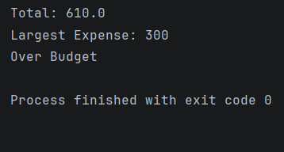
OUTPUT SCREENSHOT
CONCLUSION
The program converts travel expenses, calculates the total cost, identifies the largest expense, and checks whether the expenses are within the budget.

Slide 37
CASE STUDY 09 - Campus Event Financial Planning
OBJECTIVES
ASSUMPTIONS
To calculate venue, equipment, catering, transport, and certificate costs.
To calculate the total event cost.
To determine participant contributions.
To calculate the sponsorship shortfall.
To find the minimum number of registrations needed to break even.
All event expenses are known.
Participant registration fees are fixed.
Sponsorship amount is given.
Each participant pays the same registration fee.
The break-even count is calculated based on total costs and income.

Slide 38
CASE STUDY 09 – Algorithm & Flowchart
ALGORITHM
FLOWCHART
Start.
Enter all event costs, registration fee, and sponsorship.
Calculate total event cost.
Calculate sponsorship shortfall.
Calculate participant contributions.
Find the minimum registrations to break even.
Display the results.
Stop.
START
↓
Enter Event Costs
↓
Calculate Total Cost
↓
Calculate Shortfall
↓
Find Break-even
Registrations
↓
Display Results
↓
STOP

Slide 39
CASE STUDY 09 – PSEUDOCODE & PYTHON CODE
PSEUDOCODE
PYTHON CODE
START
INPUT event costs, fee, sponsorship
CALCULATE total cost
CALCULATE sponsorship shortfall
CALCULATE participant contributions
FIND break-even registrations
DISPLAY results
STOP
cost = 21000
sponsorship = 15000
fee = 200
shortfall = max(0, cost - sponsorship)
participants = (shortfall + fee - 1) // fee
print("Total Cost:", cost)
print("Shortfall:", shortfall)
print("Break-even Registrations:", participants)

Slide 40
CASE STUDY 09 – Testing & Conclusion
TEST CASES WITH EXPECTED OUTPUT
Test Case | Total Cost | Sponsorship | Expected Shortfall | Registrations
TC1 | 21000 | 15000 | 6000 | 30
TC2 | 20000 | 16000 | 4000 | 20
TC3 | 15000 | 15000 | 0 | 0

Slide 41
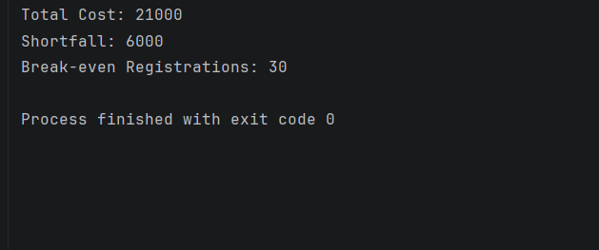
OUTPUT SCREENSHOT
CONCLUSION
The program calculates the total event cost, sponsorship shortfall, and minimum number of registrations required to break even.

Slide 42
CASE STUDY 10 - Examination Result and Grace-Mark Validation
OBJECTIVES
ASSUMPTIONS
To calculate total marks across multiple subjects.
To check subject-wise pass criteria.
To apply the specified grace-mark policy.
To ensure marks do not exceed maximum marks.
To generate the final result and classification.
Marks for all subjects are provided.
Maximum marks for each subject are fixed.
Minimum pass marks are specified.
Grace marks are given according to the policy.
Final marks cannot exceed maximum marks.

Slide 43
CASE STUDY 10 – ALGORITHM & FLOWCHART
ALGORITHM
FLOWCHART
Start.
Enter marks for all subjects.
Check subject-wise pass marks.
Apply grace marks if eligible.
Ensure marks do not exceed maximum marks.
Calculate total marks and classification.
Display the final result.
Stop.
START
↓
Enter Marks
↓
Check Pass Criteria
↓
Apply Grace Marks
↓
Validate Maximum Marks
↓
Calculate Total & Grade
↓
Display Result
↓
STOP

Slide 44
CASE STUDY 10 – PSEUDOCODE & PYTHON CODE
PSEUDOCODE
PYTHON SORCE CODE
START
INPUT subject marks
CHECK pass criteria
APPLY grace marks if eligible
LIMIT marks to maximum
CALCULATE total and grade
DISPLAY final result
STOP
marks = [35, 32, 40]
grace = 3
passed = []
for m in marks:
if m < 35 and m + grace >= 35:
m = min(m + grace, 100)
passed.append(m)
print("Marks:", passed)
print("Total:", sum(passed))
print("Result:", "Pass" if all(m >= 35 for m in passed) else "Fail")

Slide 45
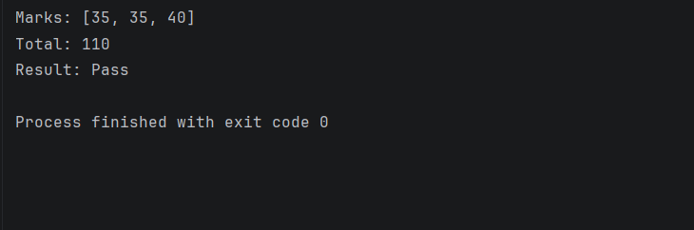
Case Study 10 – Testing & conclusion
TEST CASES WITH EXPECTED OUTPUT
OUTPUT SCREENSHOT
Test Case | Input Marks | Expected Output
TC1 | 35, 32, 40 | Total: 110, Pass
TC2 | 30, 25, 40 | Total: 95, Fail
TC3 | 50, 60, 70 | Total: 180, Pass
CONCLUSION
The program checks subject-wise marks, applies grace marks when eligible, calculates total marks, and displays the final pass or fail result.

